Slide 1
Microservices Persistent
Classroom

Slide 2
Data store
Breaking the Monolithic Database in a Microservices Architecture
Notes:
https://app.qa.com/lab/create-your-first-amazon-rds-database/ (approx. 1hr 15min)

Slide 3

Polyglot Persistence
Microservices combine components into a single service that provide a single business functionality
Microservices are autonomous, they are self-contained units
Map microservices to agile teams – A microservice is owned by a single team
A team that has ownership and controls its destiny:
Polyglot: knowing, using, or written in more than one language
Notes:
A microservice breaks down a set of components into a single service that provide a single piece of business functionality. Microservices are autonomous – they are self contained units. They can be built, tested, deployed and run independently. Any requirement to pass data back and forth is via the contractual interface. This is a relationship with another microservice, not a dependency.
Agile teams operate autonomously from other agile teams. This does not mean that they operate in a silo locking themselves away from other members of the organisation. They should be able to operate as a self-contained unit of sufficient size that the have enough skills to perform that tasks at hand. Members have good generalisation of knowledge and skills with specialisms as required – the T shaped person (Sometimes the Pi or Comb shaped person)
Those outside the agile team do not set or define the priorities or scope. Only the members of the team, the product owner and valid stakeholders have input.
Teams are big enough to be cross-functional in their skills, small enough to communicate and collaborate effectively – The two pizza team
Mapping microservices to agile teams – A microservice is owned by a single team. There would be conflict in the requirements, planning and development if the microservice was managed by more than one team.
When a team has ownership of the microservice, it controls its destiny - Choosing the correct process, tools, languages and technology that’s suitable for the individual microservices requirements and ensuring quality ~ polyglot persistence

Slide 4


Classic data store example
API Gateway
Order service
Payment service
Shipping service
What sort of challenges such a system could pose?

Slide 5




Polyglot Persistence
Datastore for each Microservice
Microservices
Monolithic Server
Monolithic Database
Journey from Monolith to Microservice
Notes:
As an example of persistently applying a Polyglot principal consider the use of a Relational Database
Our monolithic app has a connection to a monolithic database. The tables and schema has to be suitable for all of its operations. A change in the table to support a new or enhanced feature could have a negative impact on the entire schema. Just like a monolithic app, the entire database has to be tested and deployed or upgraded. This is not very flexible or efficient.
Because one feature requires a set of interrelated tables with relationships enforced through Primary/Foreign key relationships to enforce referential integrity, this may not be suitable for all features. If the relational model is OLTP then while optimised for Transactions, with good ACID compliance, it may not have the throughput required. This could be enhanced if there was less constraints on the system. Maybe the feature has to support input from many types of devices, such as IoT, there need to be flexibility in the fields (Key/Value) that are stored. In these circumstances NoSQL may be a more suitable choice.
If a relational model is used, they is still variation in the operations required – OLAP/Data warehousing may be a priority for heavy read or analytical requirements.
Correct data modelling and identifying access patterns is important here.
A core concept of being a microservice is that each service must own its own data. This ensures that the microservice is autonomous and sharing a datastore with another microservice creates a dependency. Autonomy gives the opportunity to use the best and most suitable technology to fulfil the microservice's business requirements. If relational, the best model – OLTP,OLAP or Datawarehouse. If not then perhaps NoSQL or filesystem.

Slide 6





Polyglot – Database example
Java
Flight
service
Flight
database
.Net
Hotel
service
Hotels
database
Web
Elastic
Load Balancing
UI
API
Gateway
Java
Trips search
service
Trips
database
Notes:
Looking at a microservices version of our Travel application; each microservice has its own database, however – one great thing about microservices is that we can use Polyglot in our design. Each database can choose a service or data persistence type that best suits the type of data, access frequency of our microservice.
An API gateway provides a single, unified API entry point across one or more internal APIs. They typically layer rate limiting and security as well. Provide a unified entry point for external consumers, independent of the number and composition of internal microservices.

Slide 7
Polyglot Cont. NoSQL
SQL | NoSQL
Optimized for storage | Optimized for compute
Normalized/relational | Denormalized/hierarchical
Ad hoc queries | Instantiated views
Scale vertically | Scale horizontally
Good for online analytical processing (OLAP) | Build for online transaction processing (OLTP) at scale
Notes:
Relational databases don’t easily partition horizontally, typically you have to scale vertically.
Having constraints applied during INSERT/UPDATE?DELETE operations can slow throughput. Other constraints apply to the row construct. This structured data model explicitly defined the fields to be populated within the table. Whilst NULLs could be allowed, just creating extra fields on the fly to support differing data coming from many types of users and devices is not practical.
Having a non-structured or semi-structured data model could assist in both performance and variance of data.
NoSQL has become a popular option in recent years, especially hand-in-hand with the grown of big data (though they are not exclusively linked). Using NoSQL isn’t new. But since SQL and Relational models emerged in the 1970’s and became ratified in a number of ANSI and ISO standards it has become arguably one of the most popular and successful data solutions to date. Relational Structured SQL systems will not go away. Now more then ever there is a need to get the right tool to do the job.
The need for a more flexible schema, scalability by breaking the data into different sets and distributing that sharded data across multiple nodes. Integrity now being enforced at the application level, which gives flexibility of the structure as its stores.
(Note however, this comes with its own challenges about data integrity and validation not being managed at the database level)
NoSQL offerings could be the way forward for some of our requirements and microservices.
Speed of Data Retrieval
Flexible Schema
Easy Scalability
Lighter ACID constraints (different products have varying levels of ACID support)
Transient data (User State recorded in a stateless application model)
Transient data (co-ordination of microservice events)
Indexes for other data services like AWS S3
To name but a few….
instantiated views: RDBMs/SQL gives structure with power to create ad hoc queries. NoSQL's instantiated views forces more product driven development where the developer discovers the access patterns.
For OLAP, if you don’t know what the access pattern is, an SQL database is the most appropriate option because it supports ad hoc querying. It isn’t efficient, but it is flexible. For OLTP, you always access the same way, so you can store the data on the disk in the most efficient way it needs to be accessed.
• OLTP is characterized by many short online transactions (INSERT, UPDATE, DELETE). The main emphasis for OLTP systems is on fast query processing, maintaining data integrity in multi-access environments, and an effectiveness measured by number of transactions per second (TPS). OLTP databases contain detailed and current data. The schema used to store transactional databases is the entity model (usually 3NF).
• OLAP is characterized by relatively low volume of transactions. Queries are often complex and involve aggregations. For OLAP systems, a response time is an effectiveness measure. Data mining techniques generally use OLAP applications. OLAP databases contain aggregated, historical data, stored in multi-dimensional schemas (usually star schema).
© 2020 Amazon Web Services, Inc. or its affiliates. All rights rese (AWS)
AWS. Advanced Developing on AWS 1.3 (EN): Student Guide [VitalSource Bookshelf version]. Retrieved from vbk://300-ADVDEV-13-EN-SG-E
Always check citation for accuracy before use.
Commands to run a NoSQL database
docker run --name mongo -d mongo
docker ps (to get the id like f6)
docker exec -it f6 mongosh
show dbs
use chats
show collections
db.chats.insertMany([{name: "Max", message:"Hi"}, {name: "Sasha", message:"Hello"}])
db.chats.find()
db.chats.updateOne({name: "Sasha"},{$set:{message: "Hello again!"}})
db.chats.find()

Slide 8
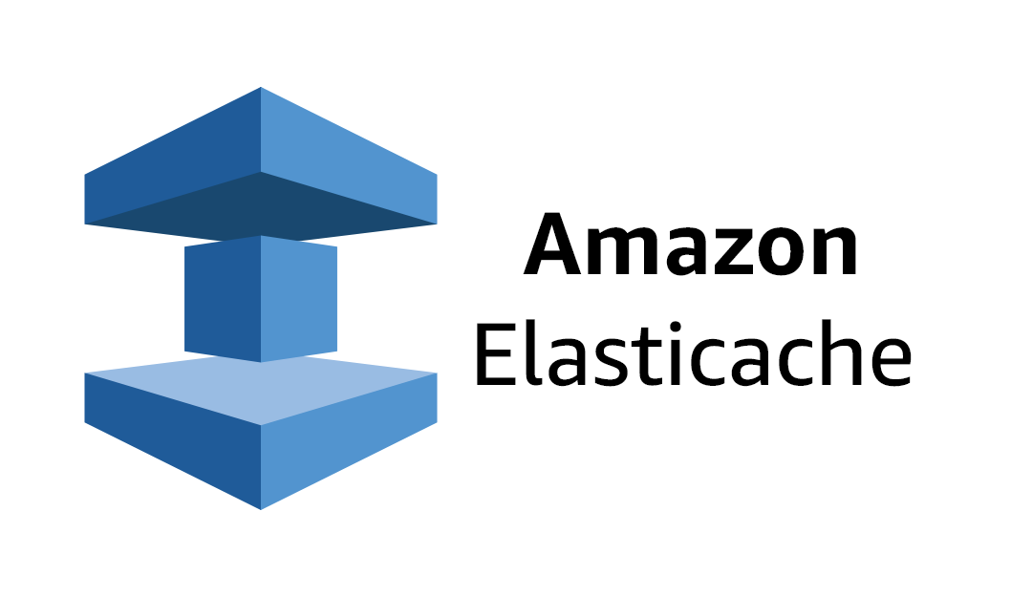
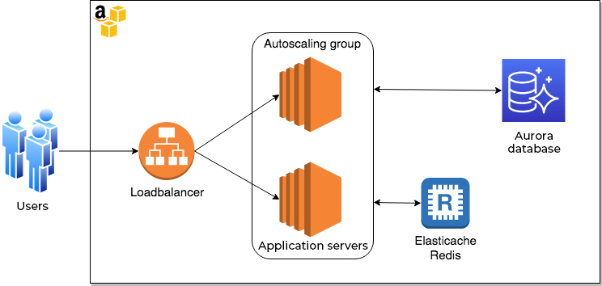
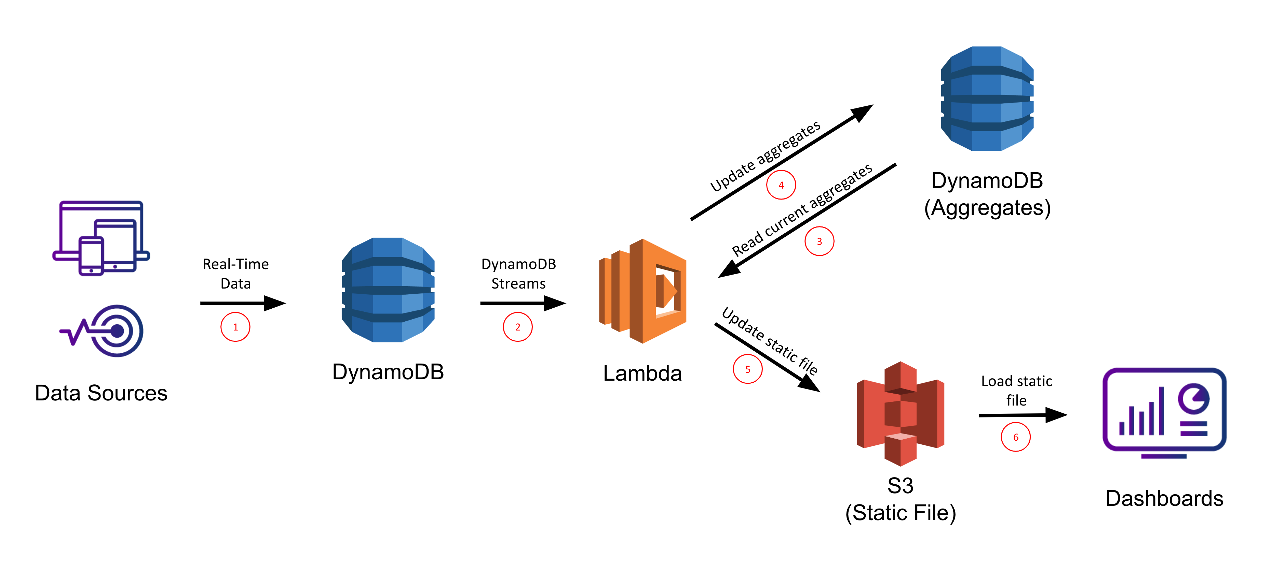
Polyglot – NoSQL (AWS)
DocumentDB
DynamoDB
Caching service using the Memcached and Redis
A MongoDB compatible document database
A serverless AWS proprietary Key/Value & Document database
Notes:
DocumentDB
MongoDB has been a popular NoSQL solution for some time. The data being stored and queried via a series of JSON type documents. DocumentDB is a managed version of MongoDB open source edition.
The main benefit is that an application as a client to MongoDB can easily migrate to this AWS Managed database with little or no changes to its code.
DynamoDB
To store numerous Key/Value pairs (or document data) in a fully managed serverless NoSQL solution, DynamoDB could be a good choice. As a table is created within DynamoDB a Primary Key must be defined. This is either as a single key (partition key) or composite PK (partition key & sort key). The partition key that you specify, together with capacity that is defined (and data size) is all used by DynamoDB to automatically store and partition the data for you. This operation breaks the data into multiple shards to distribute the load and ensure that it is a fully scalable solution. To ensure protection of the data not only can it be backed up but by default there a 6 copies of the data spread across 3 locations (Availability Zones) and encrypted at rest. Once designed and deployed correctly the developer can concentrate on data solutions and not infrastructure.
DynamoDB is well suited to NoSQL data of great variety of varying performance levels. For long term storage or more transient data such as User State etc

Slide 9
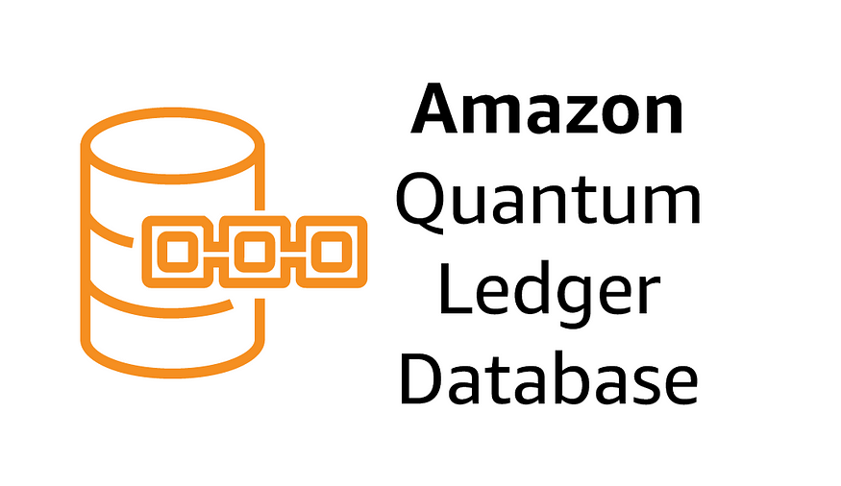
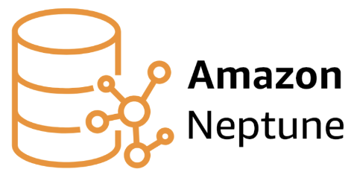
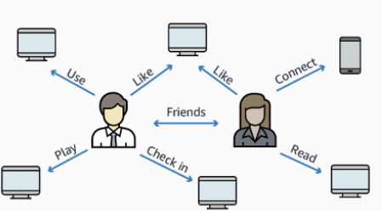
QLdb
Immutable,append only, cryptographically verifiable database
Polyglot – NoSQL (AWS)
Graph type database when the many-to-many relationship is as important as the data itself
https://www.amazonaws.cn/en/neptune/
Notes:
QLdb – Quantum Ledger Database
The requirement to be able to add data but not modify or delete is important in financial or banking sectors. Other sectors may need to be able to maintain a history that cannot be modified, such as the DVLA with car ownership.
If updates or deletes need to be made this needs to be added on as another block. All of these blocks are linked together as a chain of transactions when created. As these transactions are recorded in a new block, a cryptographic hash is generated so that the blocks and importantly the chain is verifiable. You did take that £20 out of the cashpoint!!!....and the transaction cannot be removed.
Neptune
Individuals in a social network, their chats and profiles etc are all related. Team members on a project, the documents, messages they generate are all related.
We could keep all of this data in a relational database. However the number of PK/FK relationships could be vast and the number of joins would effect performance. This is because in the relational model the primary focus in on the storage of data and the query pulls the relationships between them.
In the Graph model the relationships are as important as the data itself and subsequently stored with it. Querying the data exposes the relationship making a simpler structure and more efficient queries.

Slide 10



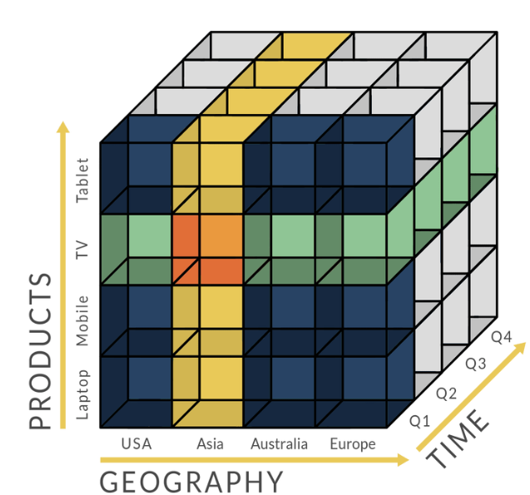
Data warehousing and OLAP
source 1
Visualisation
Extract Transform Load
source 2
Reporting
source 3
Business Intelligence
https://www.holistics.io/blog/the-rise-and-fall-of-the-olap-cube/

Slide 11
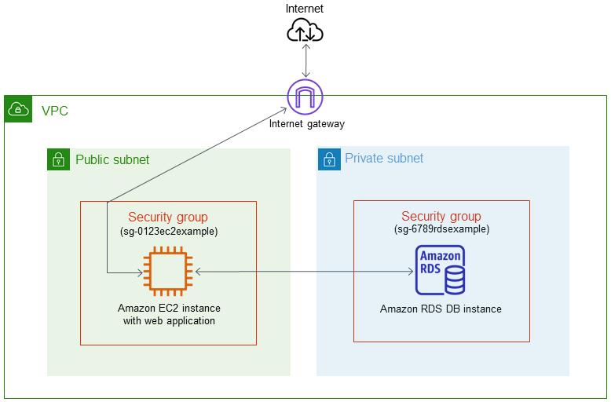
Lab activity - RDS and DynamoDB
Upon completion of this Lab, you will be able to:
Create RDS and DynamoDB databases
Use the AWS Console to create subnet groups
Manage access by using security group rules
Connect to and use the databases you create
RDBMS - RDS
NoSQL - DynamoDB
Notes:
https://app.qa.com/lab/create-your-first-amazon-rds-database/ (approx. 1hr 15min)
https://app.qa.com/lab/introduction-dynamodb/ (approx. 1hr)

